Slide 1
Biodivirsety in National Pakrs
Analysis of endangered species observations

Slide 2
The purpose of analysis
The analysis is part of my Data Science Career Path program on Codecademy.com
We are preforming data analysis of conservation statuses of the species in the National Parks

Slide 3
Data sources
We were provided with two files:
“observations.csv” where are the results of the observations, containing 23296 number of observations, containing:
“scientific_name” – scientific (latin) name of the species
“park_name”
“observations” – number of observation
“species.csv” where are listed all the species being observed, containing 5541 different species, containing:
“category” – 7 different types of species (ex. Bird, mammal, vascular plant, etc.)
“scientific_name” – scientific (latin) name of the species
“common_name”
“conservation_status” – 4 different status types (ex. Endangered, threatened, etc.)

Slide 4
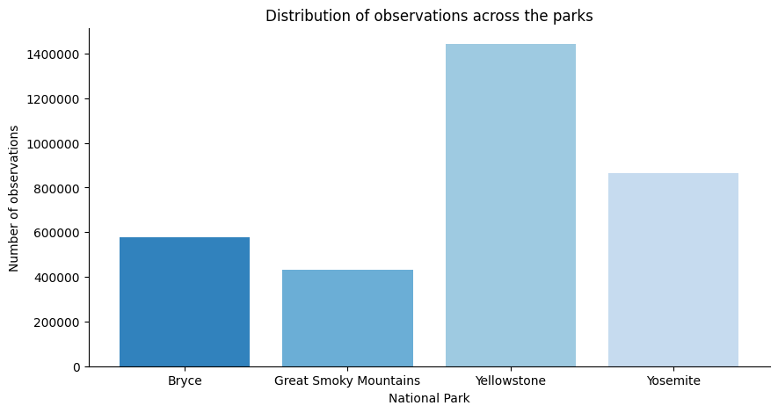
Observations by parks Total of 3.313957 observations

Slide 5
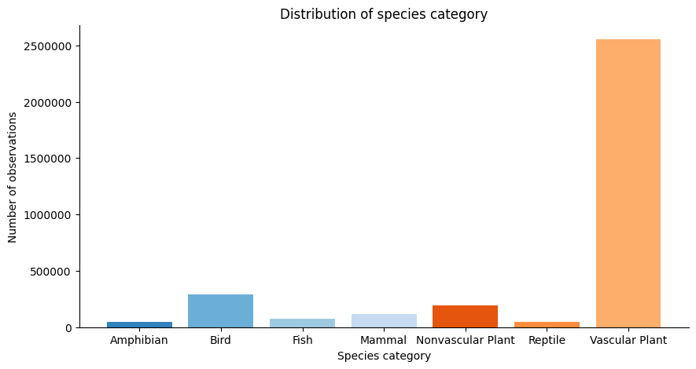
Species category observations

Slide 6
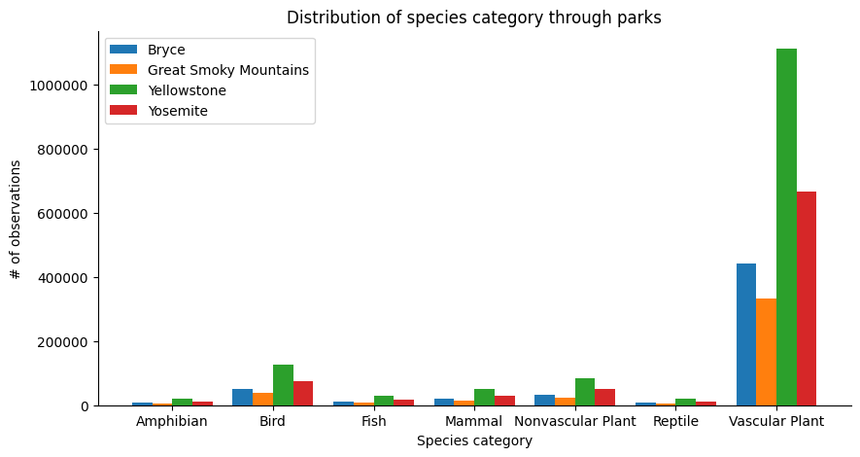
Species category observation through different parks

Slide 7
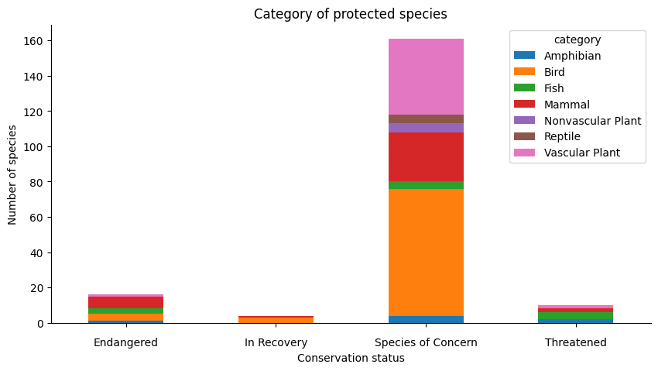
Species category and their conservation status

Slide 8
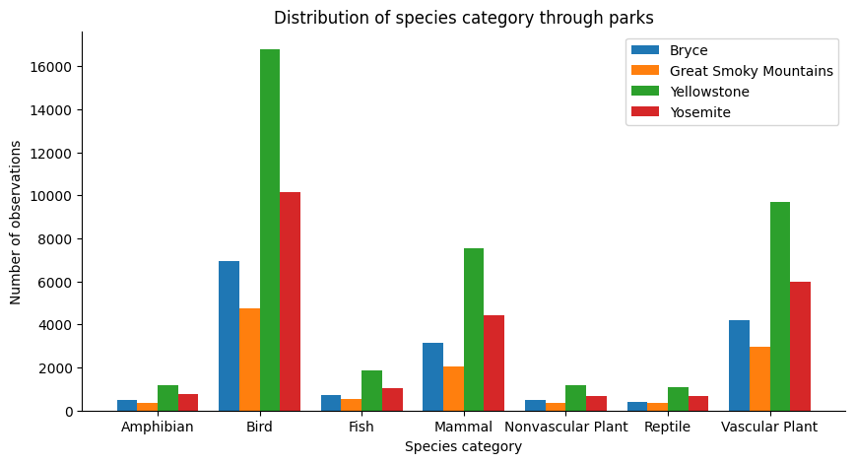
Species category through parks

Slide 9
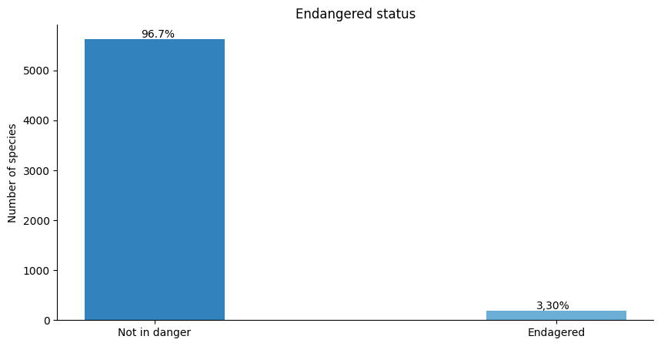
Species endangered status percentage

Slide 10
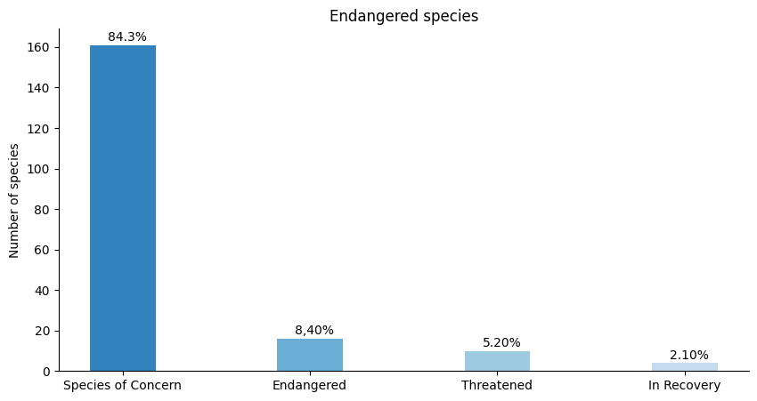
Percentage of endangered species types

Slide 11
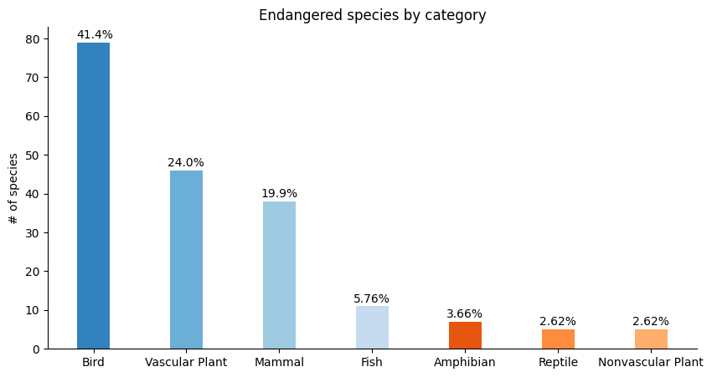
Percentage of endangered species by category

Slide 12
Conclusion
We can see that there is only a portion of the observed species that are somehow endangered - just above 3% of all observed species. Almost half of the endangered species are birds (41%), following by vascular plants and mammals (24% and 19,9%).
Most of the endangered species are "Species of concern" (more than 84%). More than 8% of endangered species are "Endangered".
We can see that there is large gap between number of observed species in parks. This could be the reason for not allocating the observations equally or just the indication of the park size, Yellowstone being the largest.

